Slide 1

Automotive Technology: A Systems Approach, 8e
Chapter 52: Disc Brakes
Rob Thompson and Jack Erjavec, Automotive Technology: A Systems Approach, 8th Edition. © 2025 Cengage. All Rights Reserved. May not be scanned, copied or duplicated, or posted to a publicly accessible website, in whole or in part.

Slide 2
Chapter Objectives (1 of 2)
52.01 List disc brake components and describe their functions.
52.02 Explain the difference between the three types of calipers commonly used on disc brakes.
52.03 Describe the two types of parking brake systems used with rear disc brakes.
52.04 Describe the causes of common disc brake problems.

Slide 3
Chapter Objectives (2 of 2)
52.05 Explain what precautions should be taken when servicing disc brake systems.
52.06 Describe the general procedure involved in replacing disc brake pads.
52.07 List and describe five typical disc brake rotor problems.
52.08 Describe rotor servicing and replacement procedures.

Slide 4
Disc Brake Advantage
Four major advantages over drum brakes:
  More resistant to heat and water fade
  Dissipates heat more effectively
  Less likely to cause pulling problems
  Automatically adjusts for pad wear

Slide 5
Disc Brake Components and Their Functions
52-01 List disc brake components and describe their functions.
Two basic types of disc brakes used today:
  Fixed caliper
  Floating or sliding caliper
Rotors can be fixed or floating, solid or vented.

Slide 6
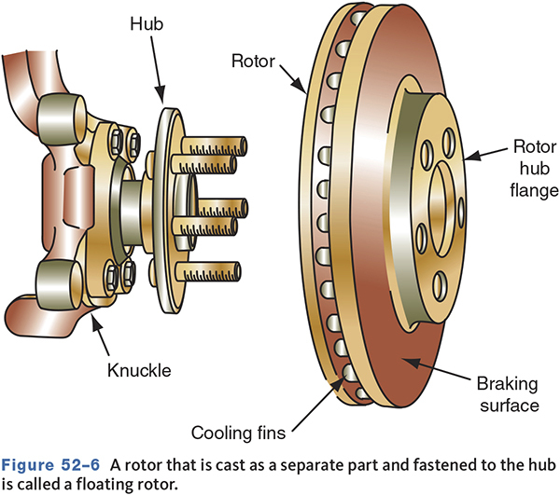
Caliper Designs

Slide 7
Rotors
Comprised of the hub and braking surface
Braking surface is machined onto both sides of the rotor.
Rotor size is determined by braking need.
Splash shields protect the inner side of the rotor and help direct air for cooling.

Slide 8
Fixed and Floating Rotors
A fixed rotor has a hub and rotor cast as a single unit.
Floating rotors are separate from the hub.
  This design is less expensive.
  More easily replaced

Slide 9
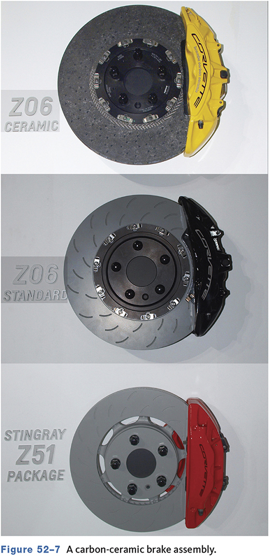
Ceramic Rotors
Standard equipment on high-end sports cars
Weigh about half as much as a conventional rotor
Last up to four times longer
Designed to be used with ceramic pads
Increased fade resistance and reduced dust

Slide 10
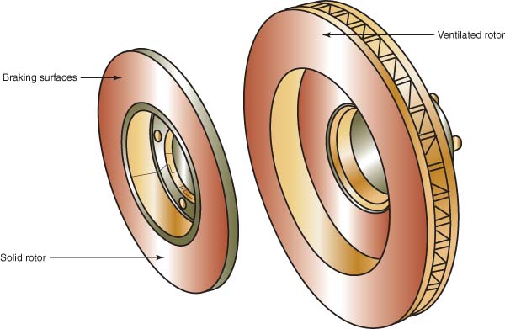
Solid and Vented Rotors
Solid rotors used on the rear
Cooling fins may be unidirectional and mount only on the right or left sides.

Slide 11
Drilled and Slotted Rotors
Used in high-performance applications
Allows heat, gases, and dirt to escape
Decreases the amount of surface area, which reduces the thermal capacity
Newer designs use tangential slots or channels

Slide 12
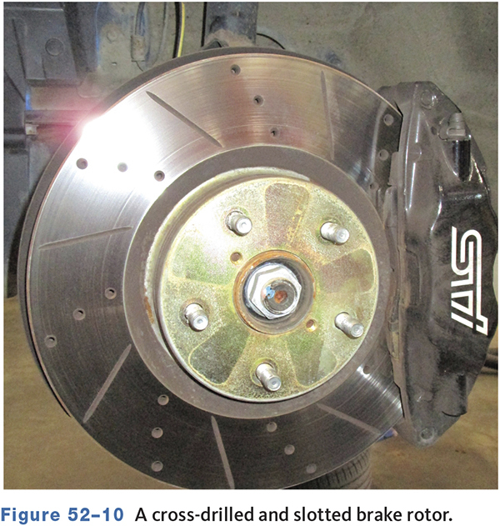
Cross-Drilled and Slotted Rotor

Slide 13
Caliper Assembly
52-02 Explain the difference between the three types of calipers commonly used on disc brakes.
Converts hydraulic pressure into mechanical force
Usually one piece cast iron or aluminum
Contains one or more pistons and seals
  Pistons can be steel or phenolic plastic.
  Inner square seal allows piston movement, seals fluid, and acts as a piston return spring.

Slide 14
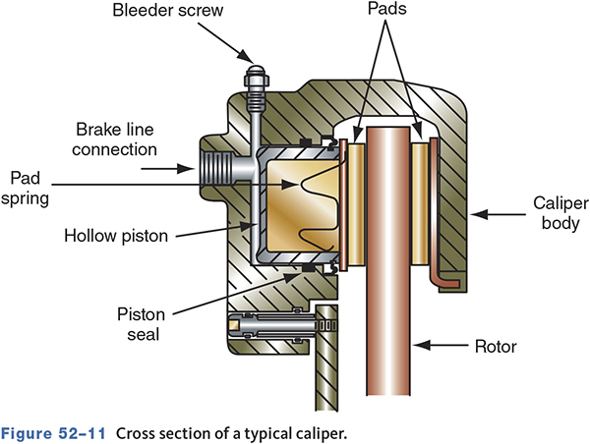
Cross Section of a Typical Caliper

Slide 15
Designs
Fixed Caliper
  The caliper is bolted in a fixed position and does not move.
Floating Caliper
  The caliper moves on locating pins.
Sliding Caliper
  It is similar to the floating type, but it does not use pins.

Slide 16
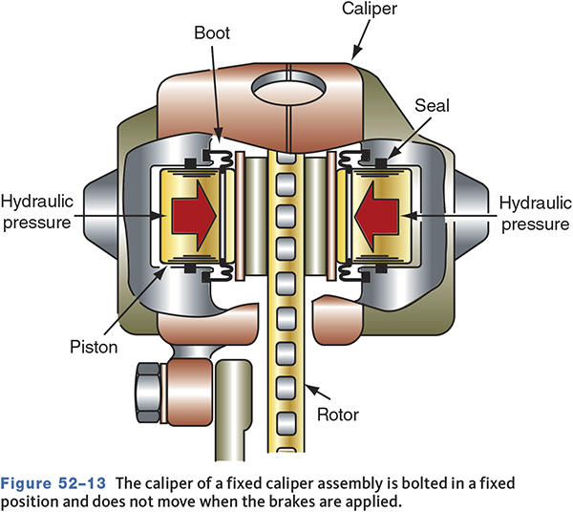
Fixed Caliper Disc Brakes
Bolted to the steering knuckle
Does not move
Pistons on both sides of the rotor apply equal force against the rotor.

Slide 17
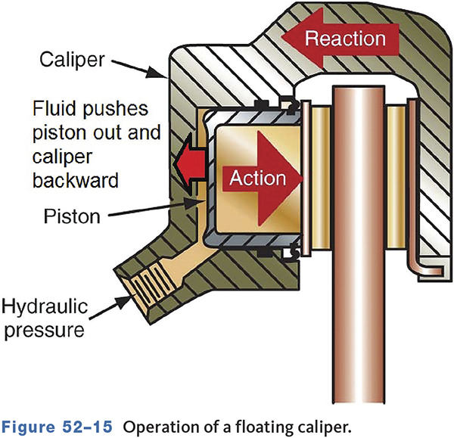
Floating Caliper Disc Brakes
Commonly a one piece caliper with one piston
Mounted on pins and bushings that allow the caliper to slide back and forth
Hydraulic pressure forces the piston out, causing the caliper to move inward.

Slide 18
Sliding Caliper Disc Brakes
Similar to the floating caliper but does not float on pins or bolts
The caliper slides on machined surfaces.
May use a support key to locate and support the caliper

Slide 19
Knowledge Check (1 of 2)
Technician A says two-piece calipers are more expensive than a one-piece caliper.
Technician B says the caliper in a fixed design does not move when the brakes are applied.
Who is correct?
Notes:
The hydraulic pressure applied to the piston forces the piston out of the caliper bore against the inner brake pad. At the same time, this action also forces the caliper to move backward, applying force against the outer brake pad. It is because of the movement of the caliper that floating and sliding calipers need to be able to move freely on their mounts.

Slide 20
Knowledge Check Answer (1 of 2)
Technician A says two-piece calipers are more expensive than a one-piece caliper.
Technician B says the caliper in a fixed design does not move when the brakes are applied.
Who is correct?
Answer: B only
Notes:
The hydraulic pressure applied to the piston forces the piston out of the caliper bore against the inner brake pad. At the same time this action also forces the caliper to move backward, applying force against the outer brake pad. It is because of the movement of the caliper that floating and sliding calipers need to be able to move freely on their mounts.

Slide 21
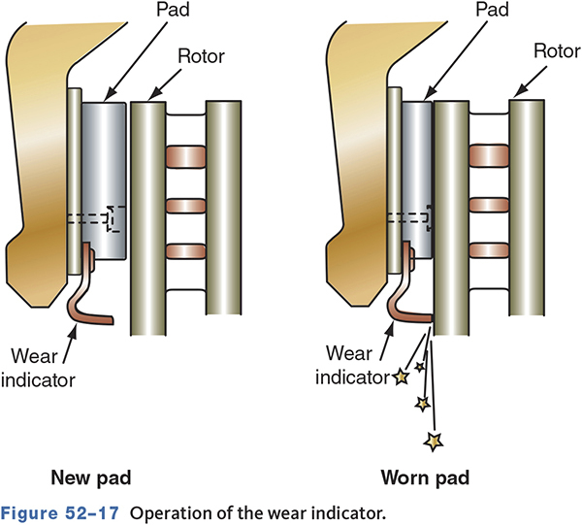
Brake Pad Assembly
Metal plates with either a bonded or riveted friction material
May have audible or electronic wear sensors

Slide 22
Rear Wheel Disc Brakes (1 of 2)
52-03 Describe the two types of parking brake systems used with rear disc brakes.
Can be of same designs as front brakes
Some rear disc brakes incorporate the parking brake mechanism into the caliper.
  This style uses a threaded piston insert to mechanically apply the pads against the rotor.

Slide 23
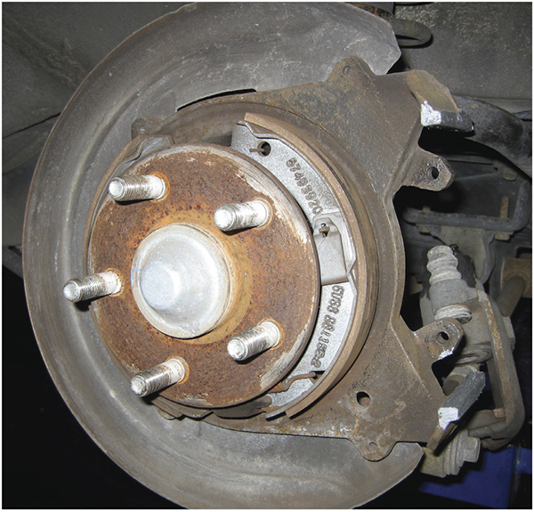
Rear Wheel Disc Brakes (2 of 2)
Many late model parking brake types use a small set of shoes housed within the rotor hat section.

Slide 24
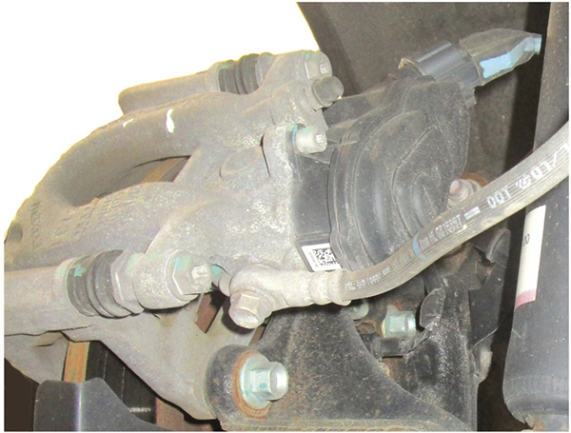
Electric Parking Brake

Slide 25
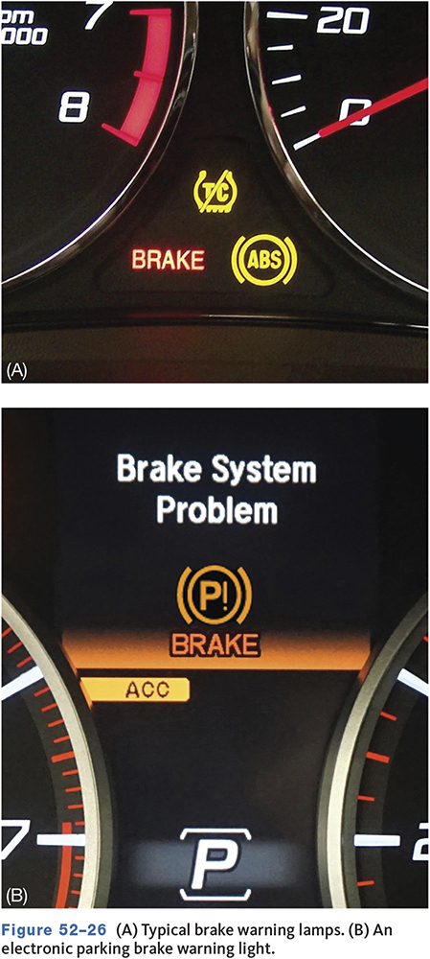
Disc Brake Lamp Diagnosis
Today’s vehicles are normally equipped with more than one brake warning light.
The red warning light indicates there is a problem in the regular brake system.
The yellow or amber brake warning light is tied into the antilock brake system (ABS).
An amber light indicates a problem with the electronic parking brake system.
A blue or yellow warning light lets the driver know the wheels are slipping.

Slide 26
Pulsating Pedal Diagnosis
  52-04 Describe the causes of common disc brake problems.
Check rotor parallelism, also called taper and thickness variation.
Measure in 6 to 8 places.
Typical parallelism spec is 0.0005”.
A warped rotor or hub can also cause a brake pedal pulsation.
Typical runout spec is 0.003”.

Slide 27
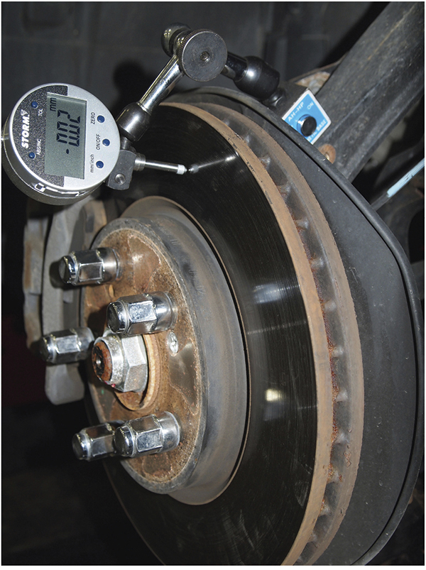
Measuring Runout

Slide 28
Disc Brake Symptom Diagnosis (1 of 2)
52-07 List and describe five typical disc brake rotor problems.
Spongy Pedal
  May need to pump the brake pedal to get good stopping ability
  Caused by air in the hydraulic system
Hard Pedal
  Usually indicates a power booster problem
  Can also be caused by restricted brake hoses and seized hydraulic cylinders

Slide 29
Disc Brake Symptom Diagnosis (2 of 2)
Dragging Brakes
  Feels as if the vehicle is losing power
  Check parking brake
  Restricted brake hoses and sticky or seized pistons
Grabbing Brakes
  Normally caused by contaminated brake linings

Slide 30
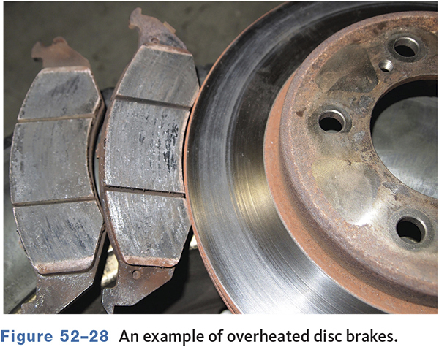
Dragging Brakes
Dragging brakes make the vehicle feel as if it has lost or is losing power as it drives down the road.
Make sure the parking brake is off.
May be caused by a restricted brake hose

Slide 31
Noise Diagnosis
Noise
  Can be from wear sensors
  Debris caught against rotor
  Loose or broken caliper/pad hardware
  Worn linings

Slide 32
Brake Pulling to One Side
Can be caused by the steering and suspension system
Check tire inflation, tire condition, and tire size
Restricted brake hoses can cause pulling.

Slide 33
Knowledge Check (2 of 2)
Technician A says a stuck rotor can cause the pads overheat.
Technician B says a stuck rotor can cause the vehicle to pull to one side when braking.
Who is correct?
Notes:
Rotor runout is the side-to-side movement or deviation from center as the rotor spins. This side-to-side variation can force the brake pads and caliper to also move side-to-side during braking. In addition, runout can also cause the brake pads to wear away at the rotor, which causes rotor thickness variation.

Slide 34
Knowledge Check Answer (2 of 2)
Technician A says a stuck rotor can cause the pads overheat.
Technician B says a stuck rotor can cause the vehicle to pull to one side when braking.
Who is correct?
Answer: Both Technicians A and B
Notes:
Rotor runout is the side-to-side movement or deviation from center as the rotor spins. This side-to-side variation can force the brake pads and caliper to also move side-to-side during braking. In addition, runout can also cause the brake pads to wear away at the rotor, which causes rotor thickness variation.

Slide 35
Service Guidelines
52-05 Explain what precautions should be taken when servicing disc brake systems.
Be sure the vehicle is properly raised and secured.
If the vehicle has antilock brakes, you may need to depressurize the system.
If working on a hybrid vehicle, read and follow the manufacturer’s brake service precautions and procedures.

Slide 36
Pre-Service Checks (1 of 2)
Tires for wear and improper inflation
Wheels for bent or warped rims
Wheel bearings for wear or looseness
Suspension components for wear or looseness
Brake fluid level
Hydraulic system for leaks

Slide 37
Pre-Service Checks (2 of 2)
Before removing a hydraulic part, use a pedal depressor to slightly depress the brake pedal.
Remove about two-thirds of the brake fluid from the master cylinder reservoir
If the bleeder screws are frozen tight with corrosion, it is sometimes possible to free them by tapping on the caliper body at the bleeder with a hammer.

Slide 38
General Caliper Inspection and Servicing
Removal
  Always follow manufacturers service procedures.
  Remove a portion of brake fluid from reservoir.
  On floating/sliding calipers, use a C-clamp to bottom the piston.
  On threaded parking brake calipers, rotate the piston back into its bore.

Slide 39
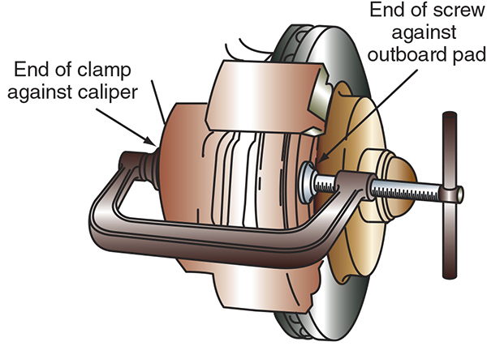
Retracting the Caliper Piston

Slide 40
Brake Pad Removal
52-06 Describe the general procedure involved in replacing disc brake pads.
Floating and sliding calipers must be lifted off the rotor for pad replacement.
Pads on fixed calipers can often be replaced by removing the pad pins.
Note position of anti-rattle clips and springs
Hang the caliper by a wire—never let the caliper hang by the hose

Slide 41
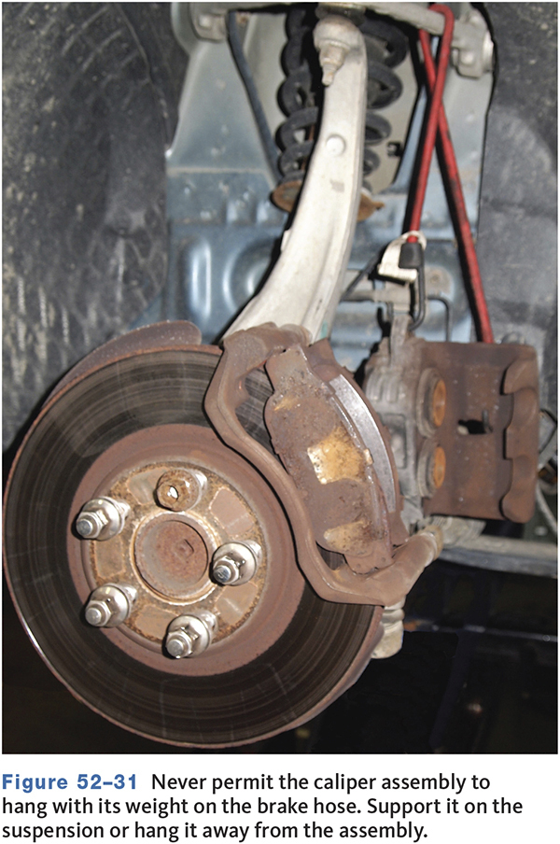
Caliper Support

Slide 42
Pad Inspection
Measure at the thinnest point
Less than 1/8” (3.175 mm) and the pads should be replaced
Uneven pad wear is often caused by a caliper that is not sliding properly.
A slightly tapered wear is normal but should not exceed 1/8” (3.175 mm).

Slide 43
Caliper Disassembly
Inspect pins and bushings—replace as needed
Remove the piston dust boot and piston
Inspect phenolic pistons for cracks and steel pistons for scoring and pitting
Check the piston bore for rust and scoring

Slide 44
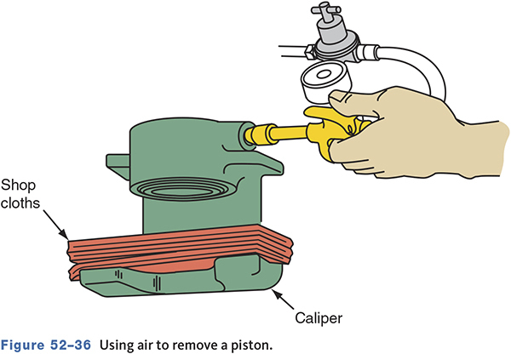
Removing the Caliper Piston

Slide 45
Loaded Calipers
Complete units with pads and mounting hardware included
Often more cost effective
Reduces chance of problems when rebuilding calipers

Slide 46
Caliper Reassembly
Clean the bore, piston, fluid passages, and all parts being reused
Lubricate the piston and seals and install
Ensure the piston is aligned exactly in the bore
A seal installer may be necessary for the dust boot.

Slide 47
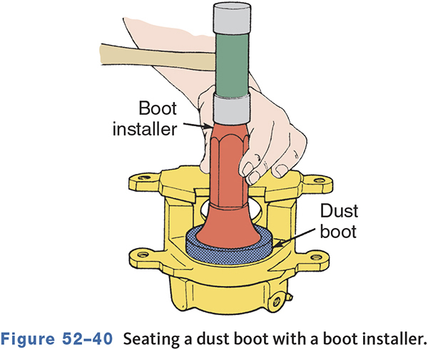
Installing Caliper Dust Boot

Slide 48
Brake Pad Installation
Always replace pad hardware.
Clean rust from all pad/caliper sliding surfaces.
Lubricate sliding surfaces with anti-seize or per the manufacturers recommendations.
Some pads require bending a retaining flange or tab to prevent looseness and noise.

Slide 49
Caliper Service Tips
Make sure the correct caliper is mounted on the correct anchor plate.
Lubricate rubber insulators with silicone dielectric compound.
If copper washers are used, always use new ones.
Fill the master cylinder and bleed the hydraulic system.
Check for leaks under maximum pedal pressure.
Road test the vehicle.

Slide 50
Rear Disc Brake Calipers
Rear disc brake calipers with an internal parking brake require special disassembly and reassembly procedures.
Always follow the manufacturers service procedures.

Slide 51
Rotor Inspection
52-08 Describe rotor servicing and replacement procedures.
Measure thickness, parallelism, and runout.
  Small grooves, 0.010” or 0.25 mm, are usually acceptable.
Check for cracks and hard spots (bluing).
Inspect vents for excessive rusting.
If beyond specifications, the rotor must be replaced.
Inspect wheel speed sensors at same time.

Slide 52
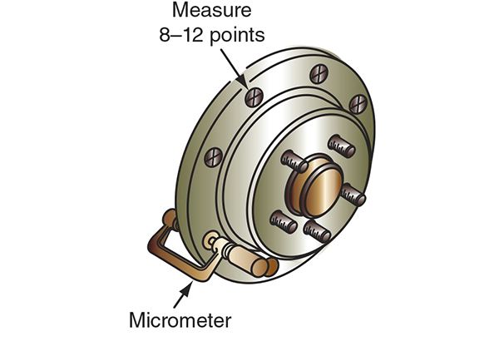
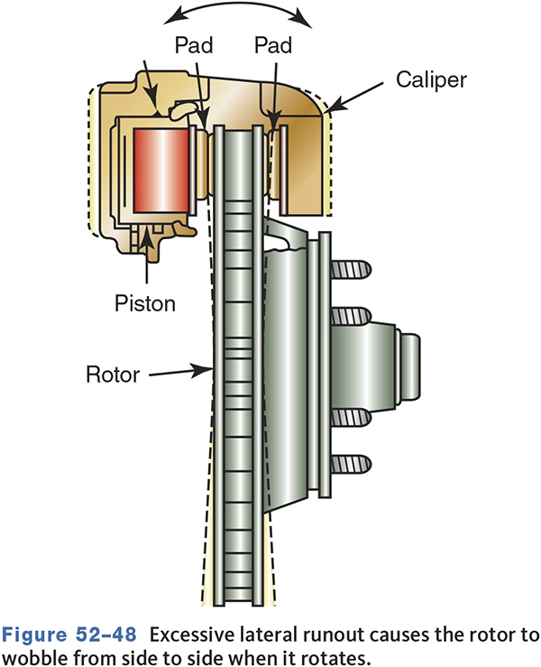
Measuring Rotors

Slide 53
Rotor Service
Before removing, mark each rotor as right and left
Two piece rotors require removing the hub and then separating the two sections.
Clean mounting surfaces on floating rotors.

Slide 54
Brake Lathes
Used to machine the rotor if there is excessive thickness variation or scoring.
Remove the least amount of metal possible.
Some manufacturers specify the use of on-vehicle brake lathes.
  Often more effective at reducing runout problems

Slide 55
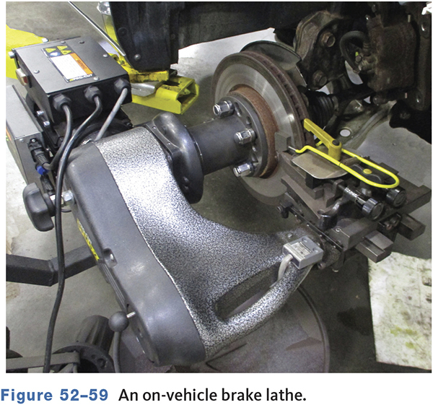
On-Car Lathe

Slide 56
Installing a Rotor
Make sure all mounting surfaces are clean.
Apply a small amount of dielectric grease to the pilot diameter of the rotor.
On fixed one-piece rotors, clean and pack the wheel bearings and hub with new grease.

Slide 57
Chapter Reflection
Describe the concept from this chapter that challenged you the most.
Describe what made the concept difficult for you and the steps you took to improve your understanding.
How could you help another student who was struggling with the same concept?
Use 100–150 words in your answer.

